Slide 1
Agile Introduction

Slide 2
WHAT HAPPENS When…??
What happens if the client asks to add new changes after design is all complete
What happens if in midway a developer comes up with an innovative way of doing things
What happens of the competitor is releasing the same kind of product 1 month earlier
What happens if the Competitor has come up with new advanced features
What happens if in between market demands changes
What happens if client’s budget scenario changes in between
What happens if a survey shows the current features are not well accepted in market by users
What happens if the client says this is not what he wanted after its showcased to him
What happens if the priority of requirements changes based on market and users
What happens if in between there is a conflict in understanding of the developers and the providers
These scenarios reflects the CHANGING TIMES w.r.t. market and user demands
AGILE methodology addresses all the above

Slide 3
Need for Agile
Time to market becoming crucial
Budgets are shrinking
Requirements not clear upfront or being developed concurrently
Agile project management methods like Scrum can be applied to any project effort to deliver improved results in ever evolving business environments, and do so in a manner that demonstrates visible, predictable progress toward today’s most important business priorities.
Agility is the ability to both create and respond to change in order to profit in a turbulent business environment. - Jim Highsmith, Agile Project Management .

Slide 4
Sunrise of Agile
In late 1990's several methodologies began to get increasing public attention.
They all emphasized
close collaboration between the programmer team and business experts;
face-to-face communication (as more efficient than written documentation);
frequent delivery of new deployable business value;
tight, self-organizing teams;
and ways to craft the code and the team such that the inevitable requirements churn was not a crisis.
Early 2001 saw a workshop in Snowbird, Utah, USA, where various originators and practitioners of these methodologies met to figure out just what it was they had in common.
They picked the word "agile" for an umbrella term and crafted the Manifesto

Slide 5
Agile Manifesto
We are uncovering better ways of developing software by doing it and helping others do it. Through this work we have come to value: (www.agilemanifesto.org)
Individuals and Interactions over Processes and Tools
Working Software over Comprehensive Documentation
Customer Collaboration over Contract Negotiation
Responding to Change over Following a Plan
That is, while there is value in the items on the right, we value the items on the left more

Slide 6
Principles behind the Agile Manifesto
Our highest priority is to satisfy the customer through early and continuous delivery
Welcome changing requirements, even late in development
Deliver working software frequently, from a couple of weeks to a couple of months
Business people and developers must work together daily throughout the project
Build projects around motivated individuals. Give them the environment and support they need, and trust them to get the job done.
The most efficient and effective method of conveying information to and within a development team is face-to-face communication
Continuous attention to technical excellence and good design enhances agility
At regular intervals, the team reflects on how to become more effective, then tunes and adjusts its behavior accordingly

Slide 7
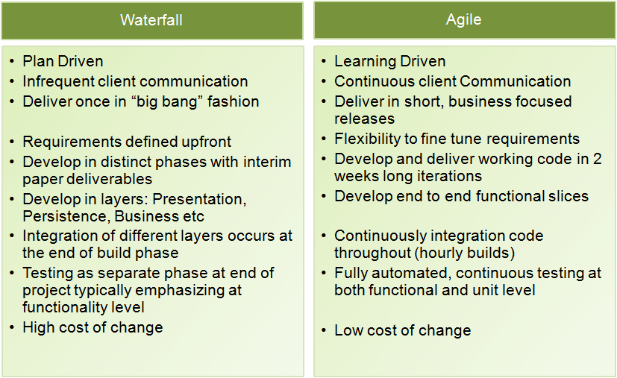
Agile Vs Traditional approach

Slide 8
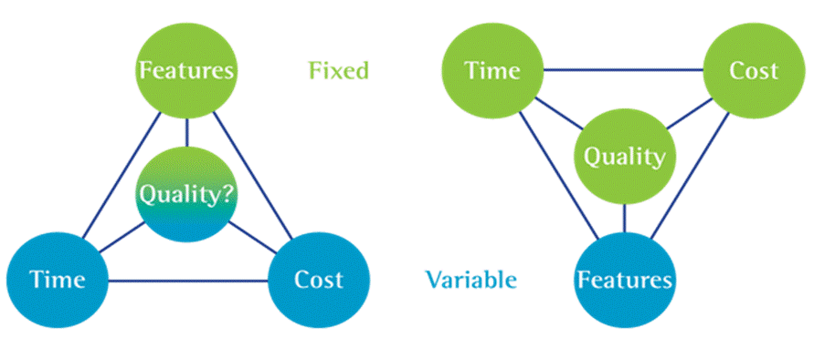
Project Constraints
Traditional Approach
Agile Approach
Time and Cost is variable
Quality at Risk
Focus on Quality
Manage Changes to Features
Deliver Within Time and Cost

Slide 9
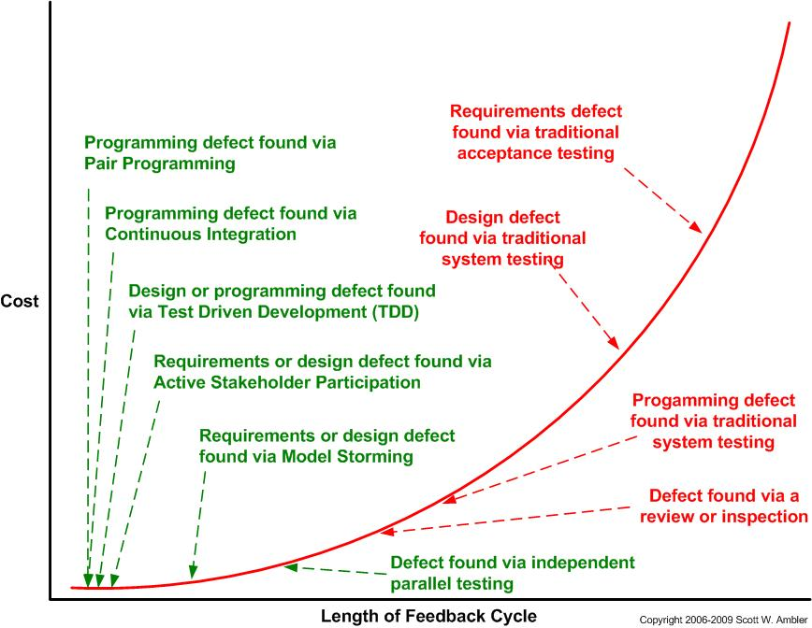
Cost of change curve

Slide 10
Benefits of Agile
Visibility
Adaptability
Agile
Agile
Satisfaction
Traditional
Traditional
Agile
Risk
Traditional
Agile
Notes:
In particular, agile development accelerates the delivery of initial business value, and through a process of continuous planning and feedback, is able to ensure that value is continuing to be maximized throughout the development process. As a result of this iterative planning and feedback loop, teams are able to continuously align the delivered software with desired business needs, easily adapting to changing requirements throughout the process. By measuring and evaluating status based on the undeniable truth of working, testing software, much more accurate visibility into the actual progress of projects is available. Finally, as a result of following an agile process, at the conclusion of a project is a software system that much better addresses the business and customer needs.
The diagram below displays the differences between agile and waterfall development processes. By delivering working, tested, deployable software on an incremental basis, agile development delivers increased value, visibility, and adaptability much earlier in the life cycle, significantly reducing project risk

Slide 11
Agile Methods
Method | Key Points | Special Features
Scrum | Independent, small, self-organizing development teams, 30-day release cycles. Most used and popular along with XP | Enforce a paradigm shift from the “defined and repeatable” to the “new product development view of Scrum”.
XP | Customer driven development, small teams, daily builds | Refactoring – the ongoing redesign of the system to improve its performance and responsiveness to change
DSDM | Application of controls to RAD, use of time boxing, empowered DSDM teams, active consortium to steer the method development | First truly agile software development method, use of prototyping, several user roles: “ambassador”, “visionary” and “advisor”. Follows MOSCOW approach for feature prioritization
RUP | Complete software development model including tool support. Activity driven role assignment | Business modelling, tool family support
FDD | Feature Driven Development | Develop overall model, Build a Feature List, Plan by Feature, Design by Feature, Build by Feature
Notes:
Dynamic systems development method (DSDM)-DSDM fixes cost, quality and time at the outset and uses the MoSCoW prioritisation of scope into musts, shoulds, coulds and won't haves to adjust the project deliverable to meet the stated time constraint
Rational unified process

Slide 12
Recommended Websites & Books
Websites
www.agilealliance.com
www.mountaingoatsoftware.com
www.controlchaos.com
Textbooks
Scrum Guide by Ken Schwaber and Jeff Southerland
Reference Books
Agile Software Development with Scrum
By Ken Schwaber and Mike Beedle
Agile Project Management with Scrum
Ken Schwaber and Mike Beedle

